Slide 1
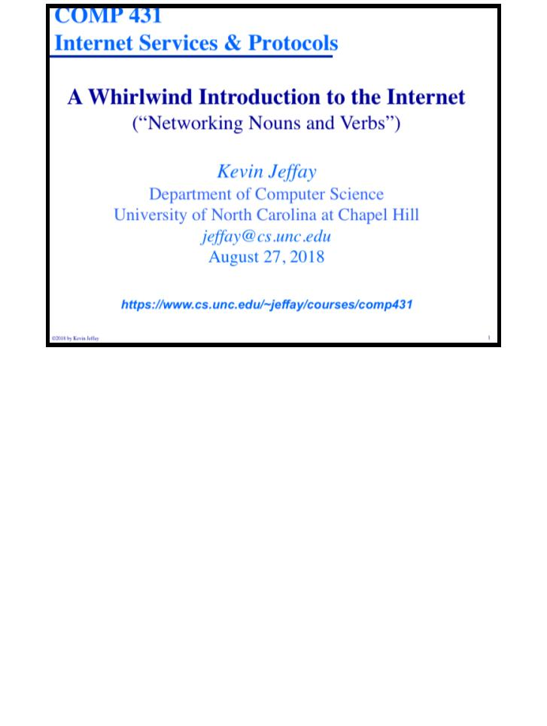
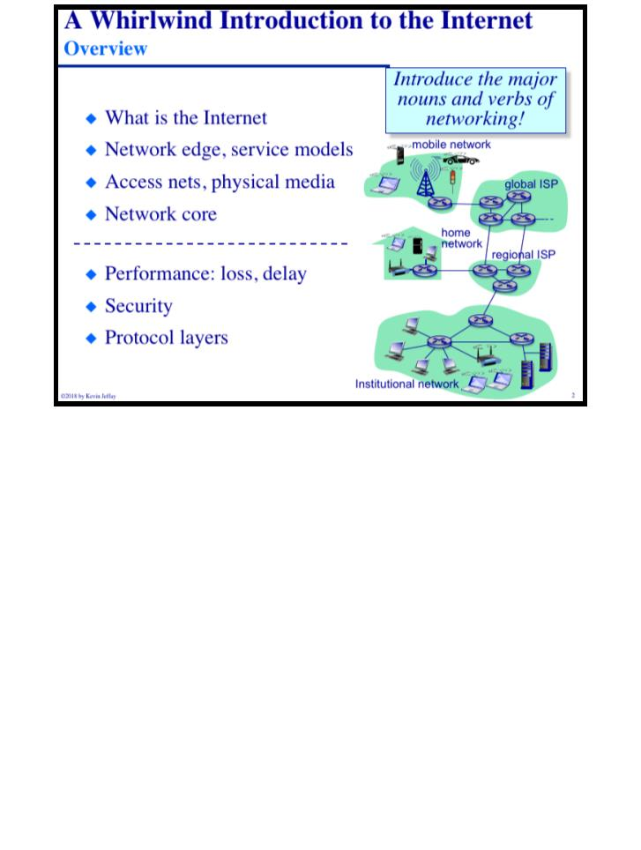
Printed on Sunday, August 26, 2018 at 4:24 PM.
COMP 431
© 2018 by Kevin Jeffay
Lecture 1, WhirlwindIntro
August 27, 2018
Page 1
COMP 431
© 2018 by Kevin Jeffay
Lecture 1, WhirlwindIntro
August 27, 2018
Page 2

Slide 2
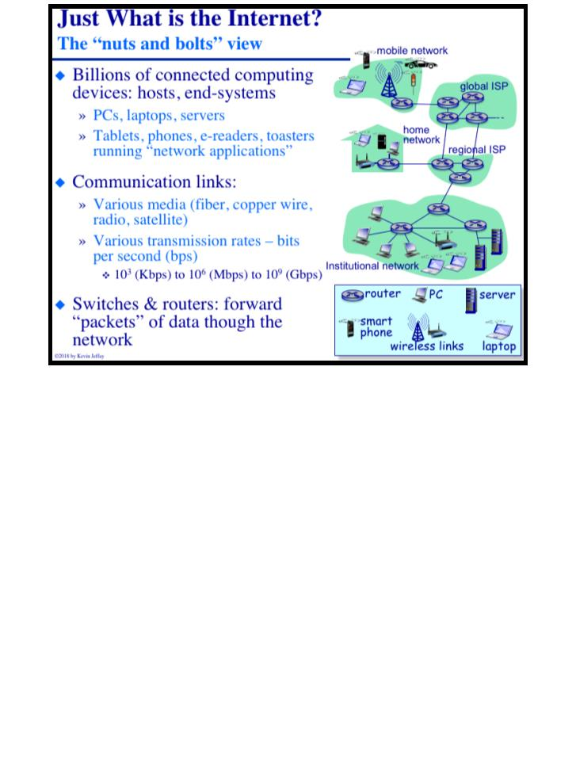
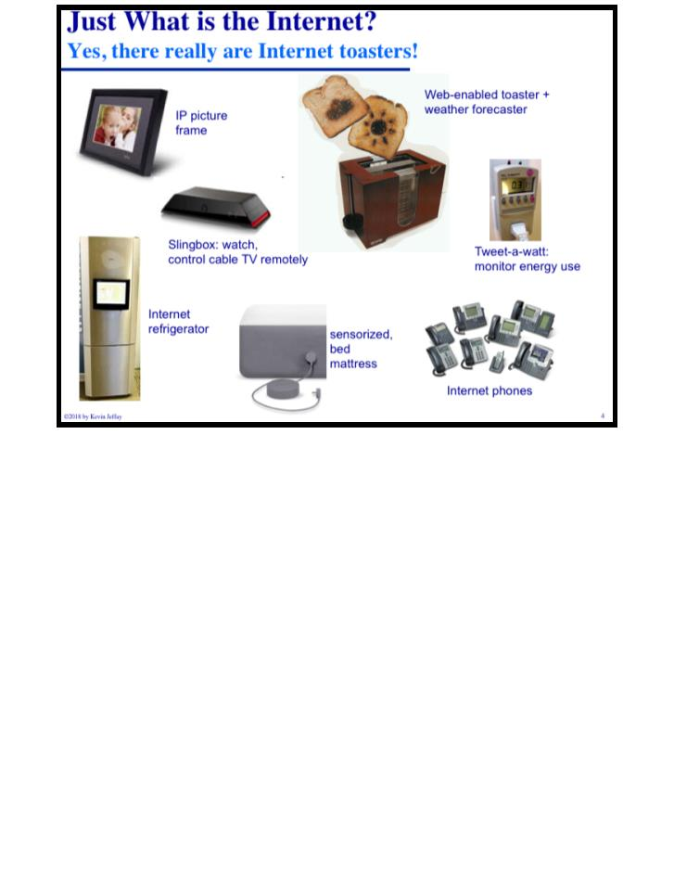
COMP 431
Lecture 1, WhirlwindIntro
August 27, 2018
COMP 431
© 2018 by Kevin Jeffay
Lecture 1, WhirlwindIntro
August 27, 2018
© 2018 by Kevin Jeffay
Page 3
Page 4

Slide 3
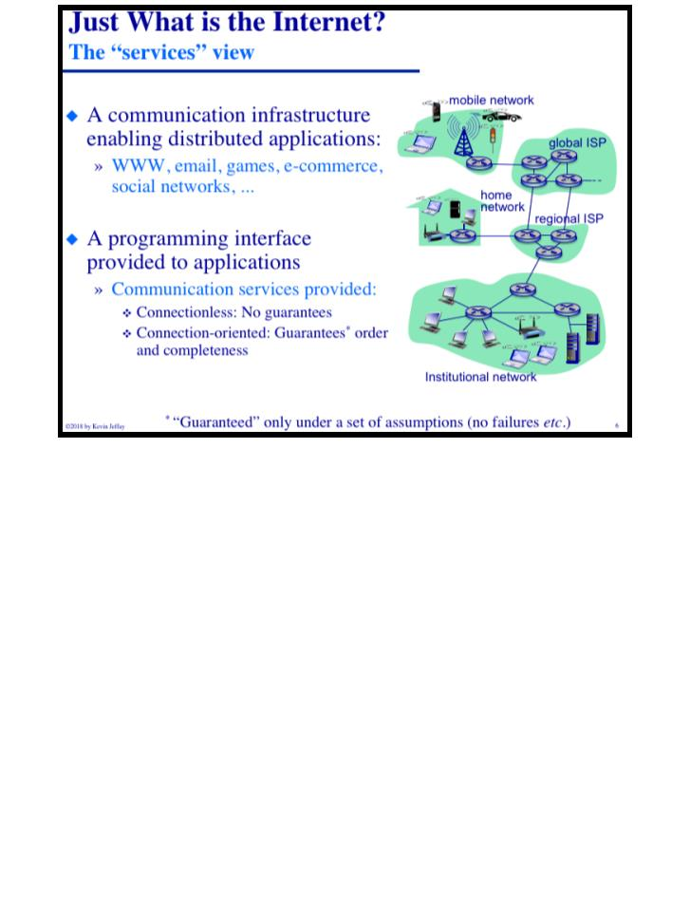
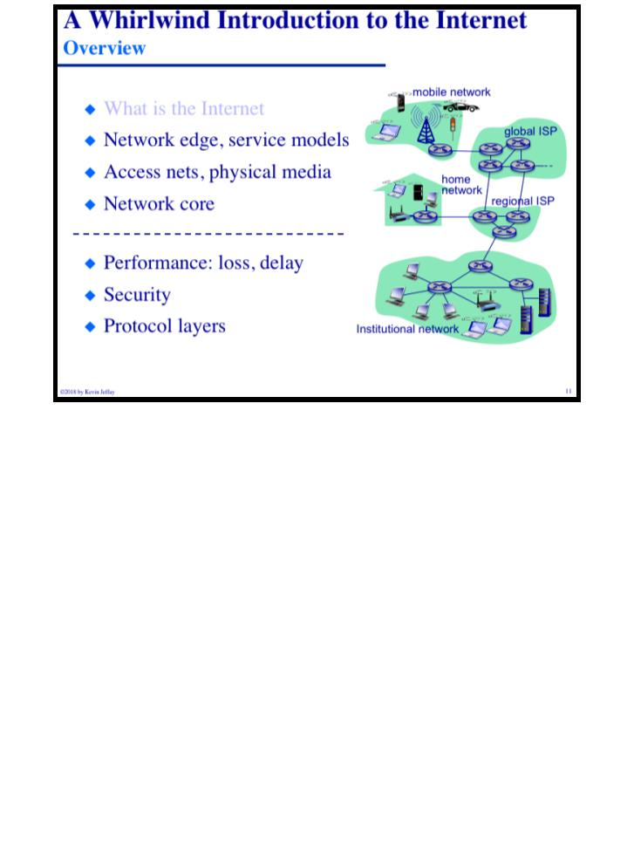
COMP 431
Lecture 1, WhirlwindIntro
August 27, 2018
COMP 431
© 2018 by Kevin Jeffay
Lecture 1, WhirlwindIntro
August 27, 2018
© 2018 by Kevin Jeffay
Page 6
Page 11
Notes:
Connectionless: No guarantee that the data is delivered or that it is in the correct order. Has less overhead.

Slide 4
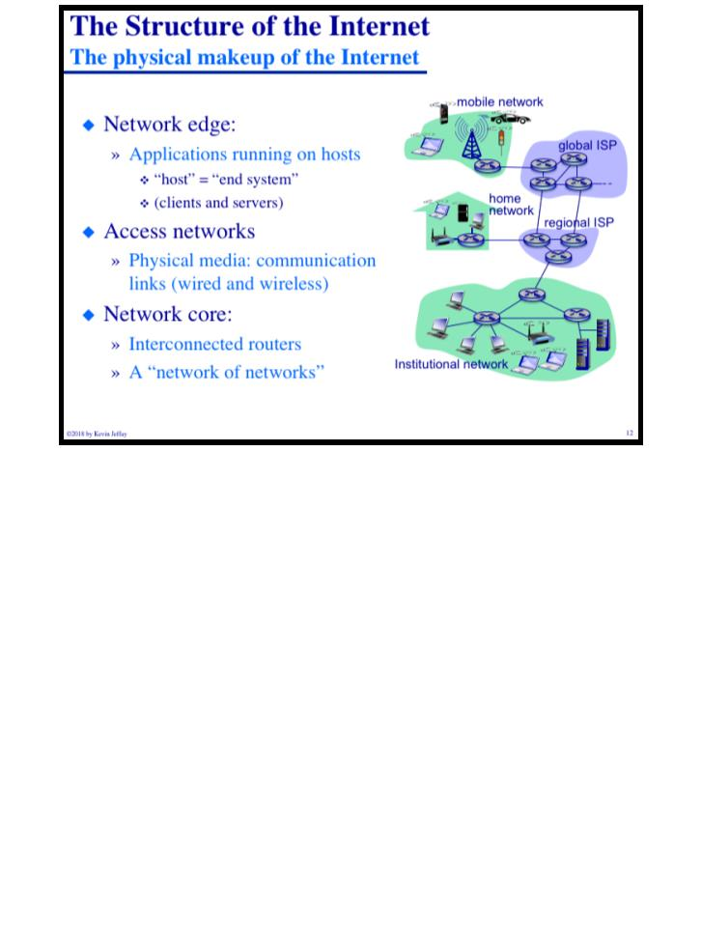
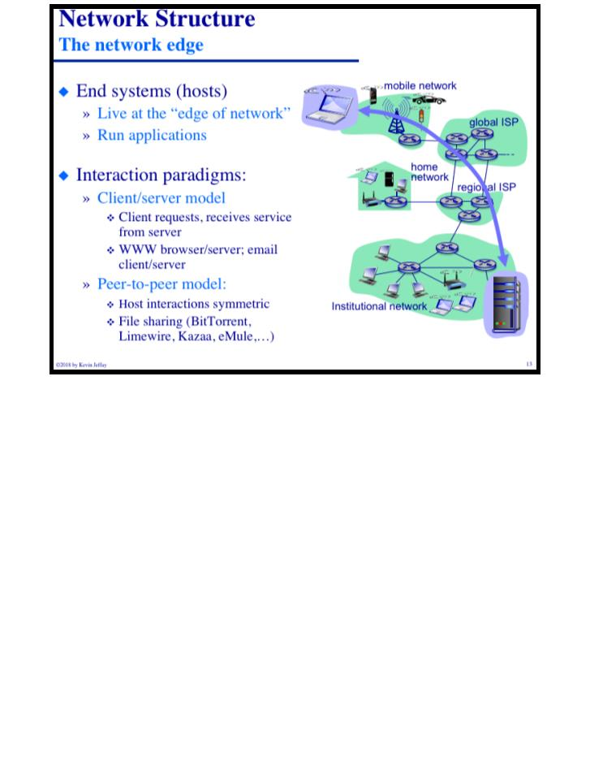
COMP 431
Lecture 1, WhirlwindIntro
August 27, 2018
COMP 431
© 2018 by Kevin Jeffay
Lecture 1, WhirlwindIntro
August 27, 2018
© 2018 by Kevin Jeffay
Page 12
Page 13

Slide 5
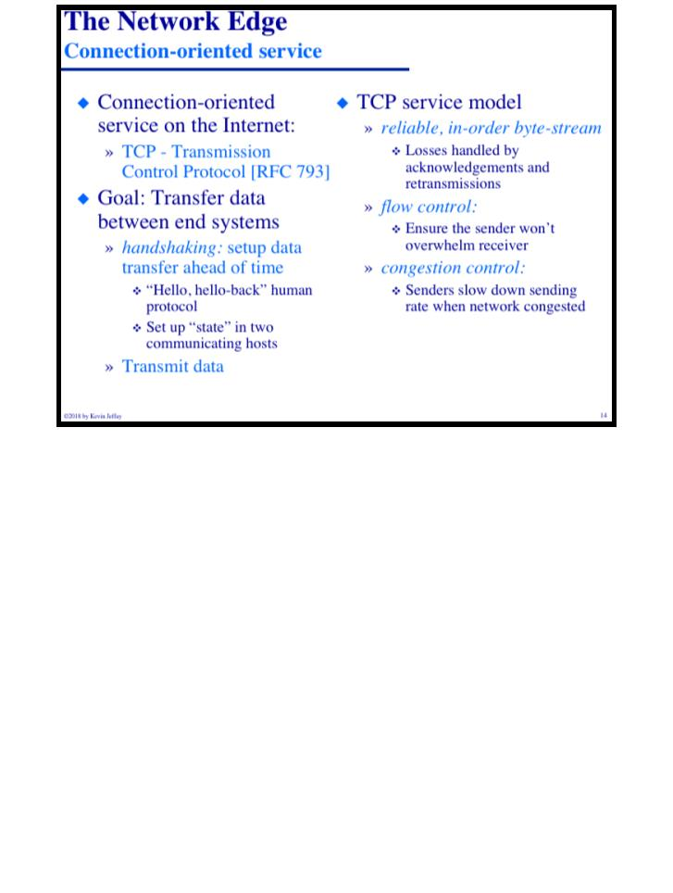
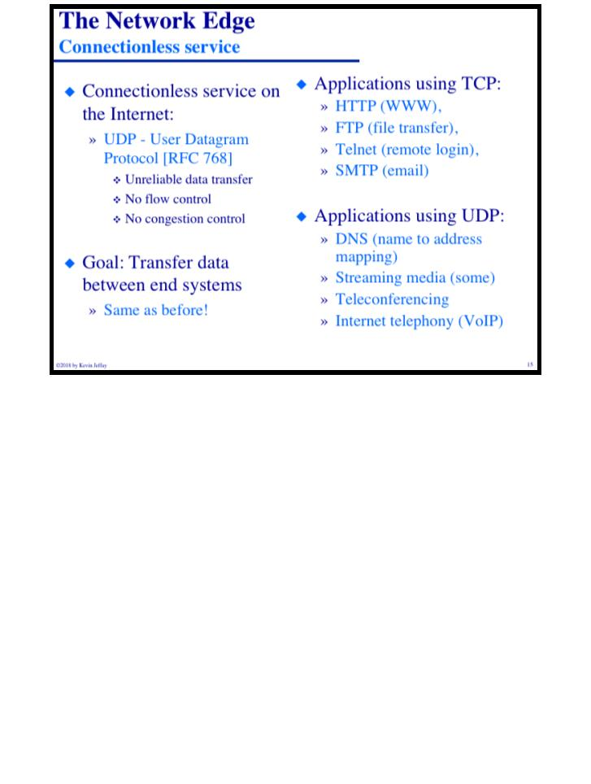
COMP 431
Lecture 1, WhirlwindIntro
August 27, 2018
COMP 431
© 2018 by Kevin Jeffay
Lecture 1, WhirlwindIntro
August 27, 2018
© 2018 by Kevin Jeffay
Page 14
Page 15
Notes:
TCP tries to control the rate use flow control so that the receiver isn’t overlaoded (flow control) and so that there aren’t traffic jams (congestive control)
UDP is still used because it doesn’t want the overhead, but not nearly as popular as TCP. UDP is used by DNS

Slide 6
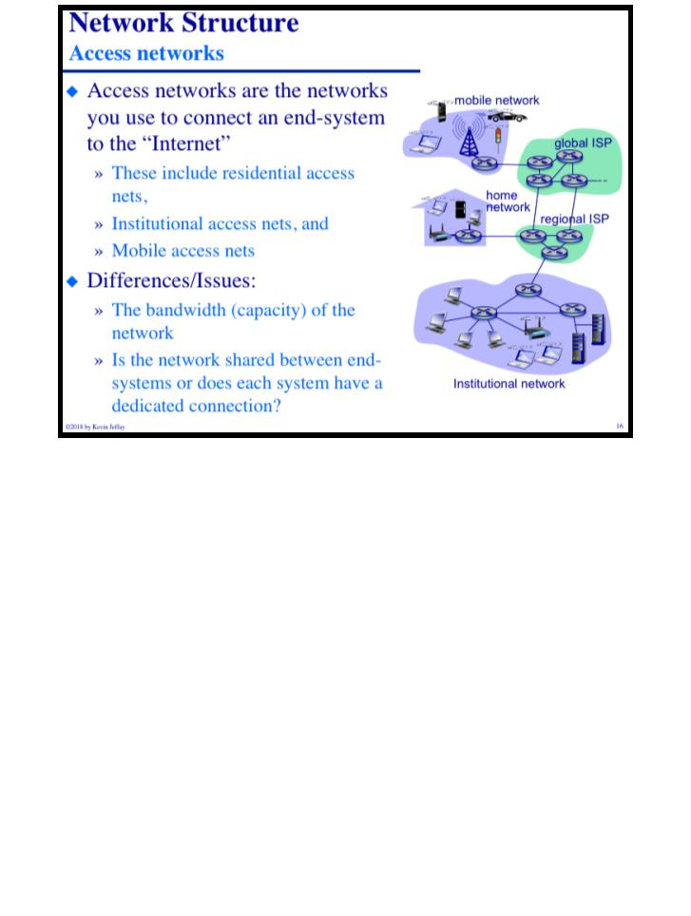
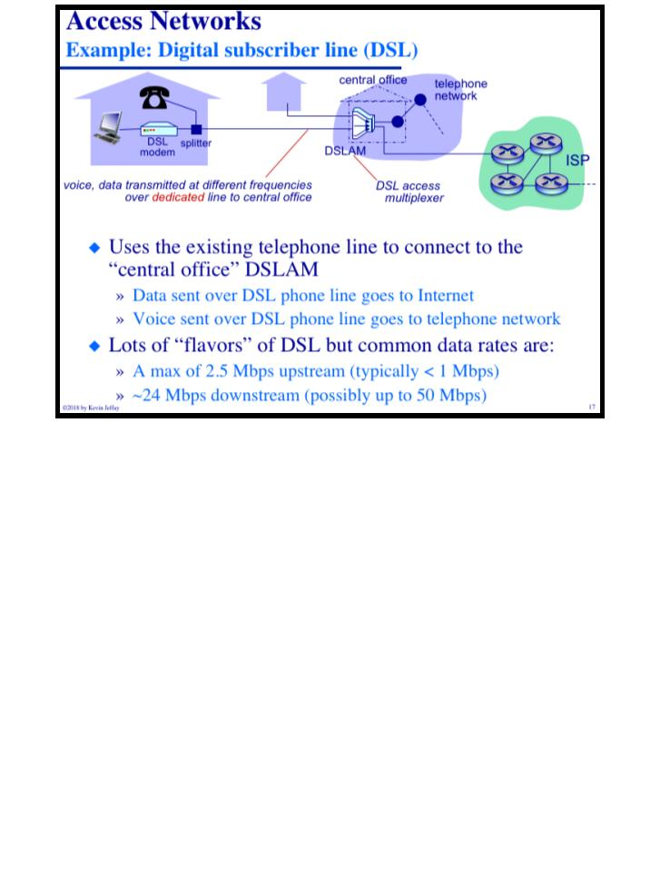
COMP 431
Lecture 1, WhirlwindIntro
August 27, 2018
COMP 431
© 2018 by Kevin Jeffay
Lecture 1, WhirlwindIntro
August 27, 2018
© 2018 by Kevin Jeffay
Page 16
Page 17
Notes:
DSL means your telephone and internet are using the same cable, but they’re on different frequencies.

Slide 7
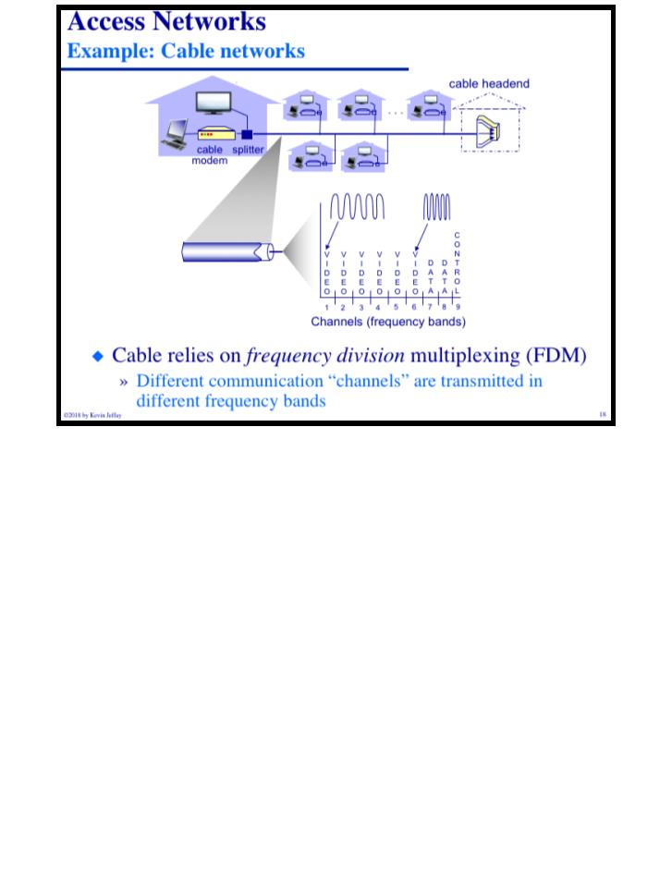
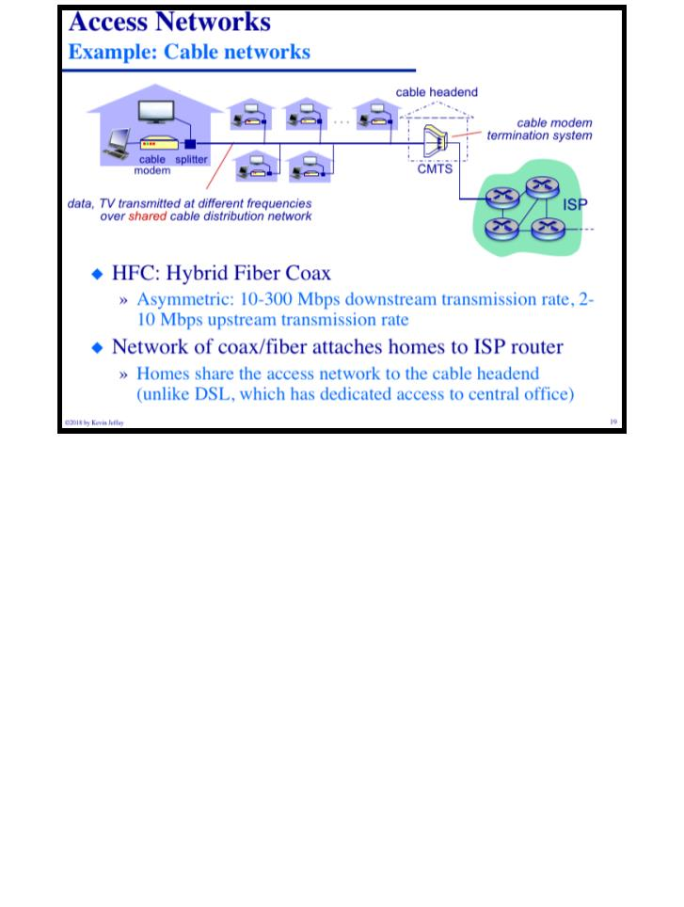
COMP 431
Lecture 1, WhirlwindIntro
August 27, 2018
COMP 431
© 2018 by Kevin Jeffay
Lecture 1, WhirlwindIntro
August 27, 2018
© 2018 by Kevin Jeffay
Page 18
Page 19
Notes:
Cable is shared with 50-200 other homes. It uses the spectrum where all of the TV is transmitted and just transmits data on it instead.
Fiber close to the servers, coax close to the house. The whole “fiber” thing is just bringing the fiber closer to the house. Two homes cant transmit dta at the same time because it’s not in paralllel like DSL>

Slide 8
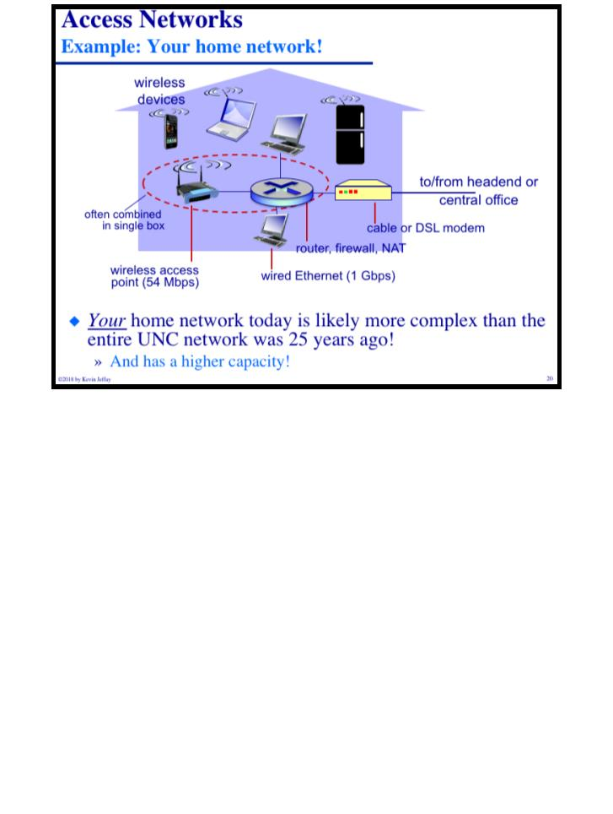
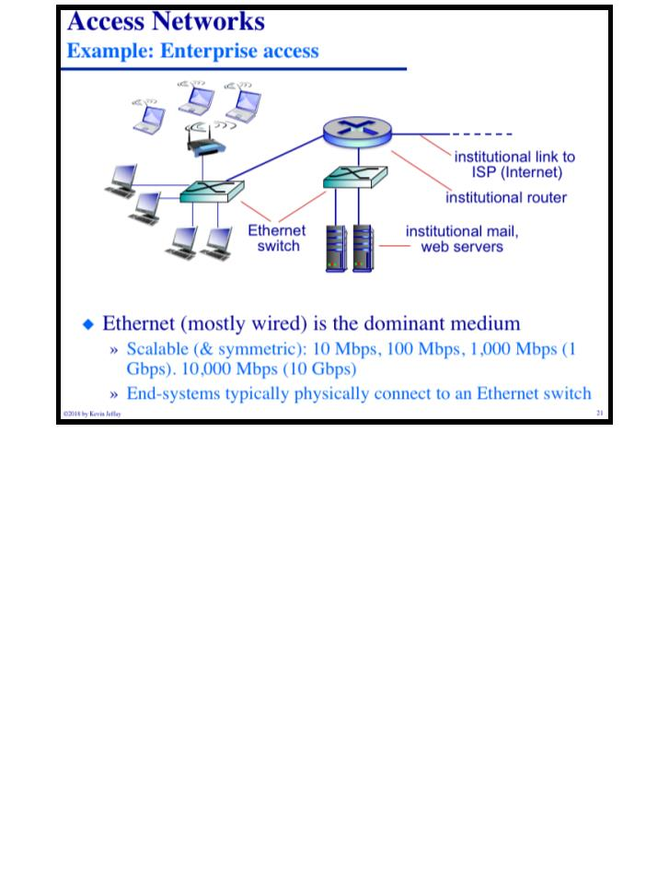
COMP 431
Lecture 1, WhirlwindIntro
August 27, 2018
COMP 431
© 2018 by Kevin Jeffay
Lecture 1, WhirlwindIntro
August 27, 2018
© 2018 by Kevin Jeffay
Page 20
Page 21

Slide 9
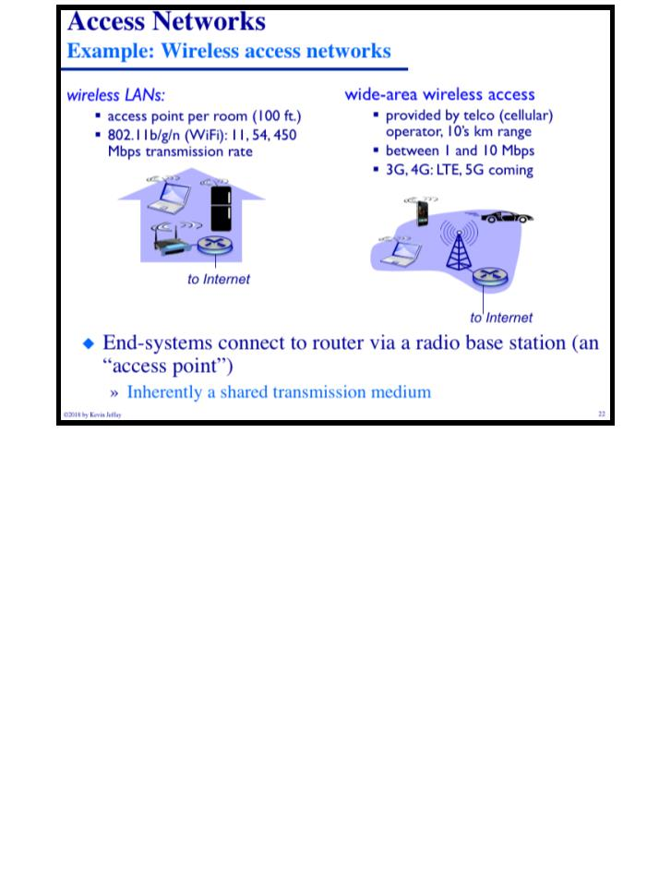
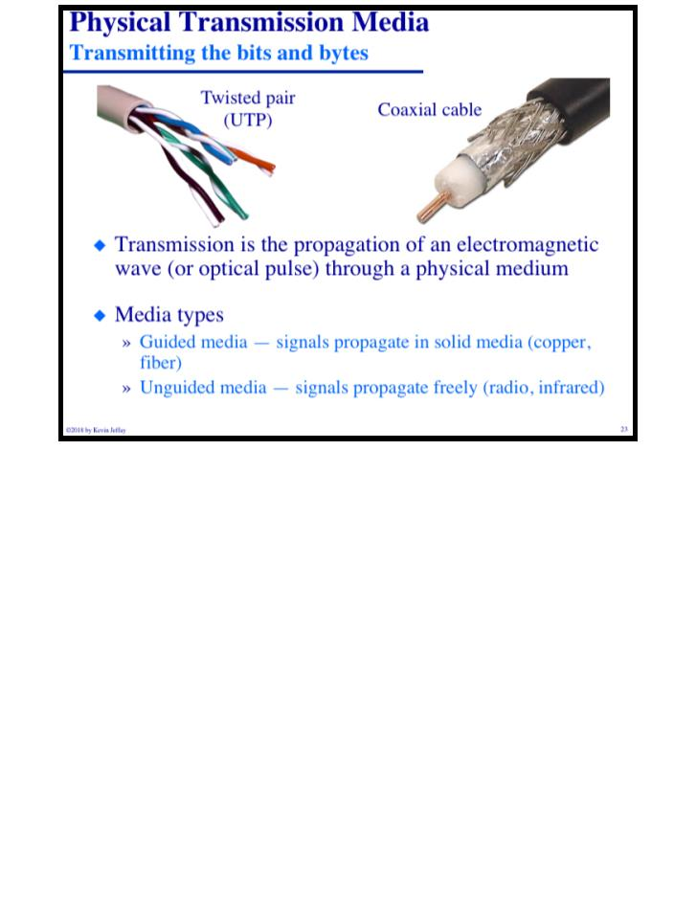
COMP 431
Lecture 1, WhirlwindIntro
August 27, 2018
COMP 431
© 2018 by Kevin Jeffay
Lecture 1, WhirlwindIntro
August 27, 2018
© 2018 by Kevin Jeffay
Page 22
Page 23
Notes:
Twisted pair is used for ethernet usually. Coax is used as an antenna essentially.

Slide 10
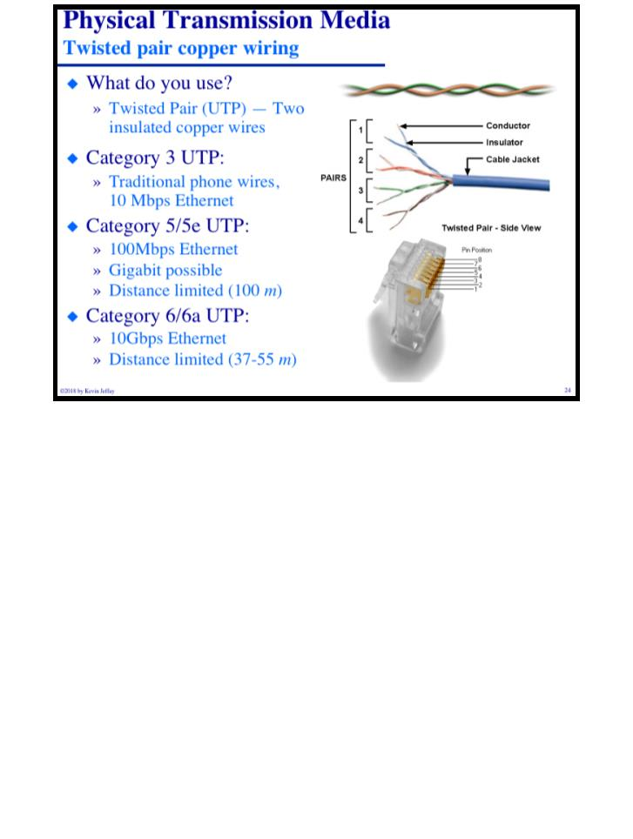
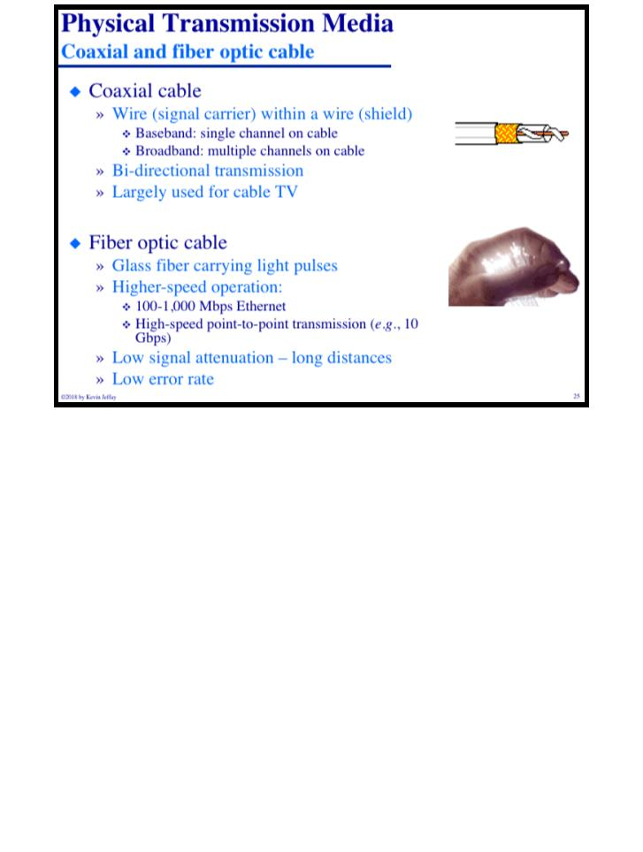
COMP 431
Lecture 1, WhirlwindIntro
August 27, 2018
COMP 431
© 2018 by Kevin Jeffay
Lecture 1, WhirlwindIntro
August 27, 2018
© 2018 by Kevin Jeffay
Page 24
Page 25
Notes:
Fiber optic isn’t immune to interferene. Literally just shooting a laser through glass.

Slide 11
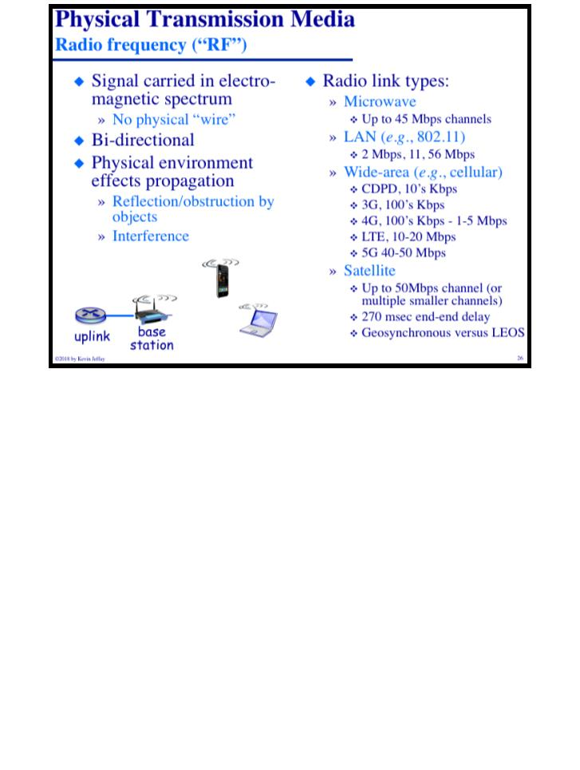
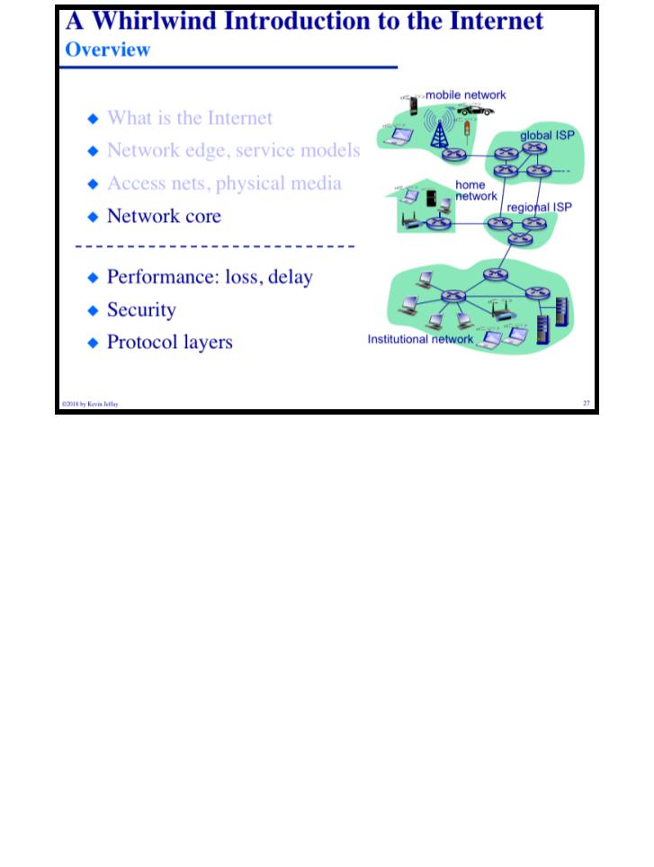
COMP 431
Lecture 1, WhirlwindIntro
August 27, 2018
COMP 431
© 2018 by Kevin Jeffay
Lecture 1, WhirlwindIntro
August 27, 2018
© 2018 by Kevin Jeffay
Page 26
Page 27

Slide 12
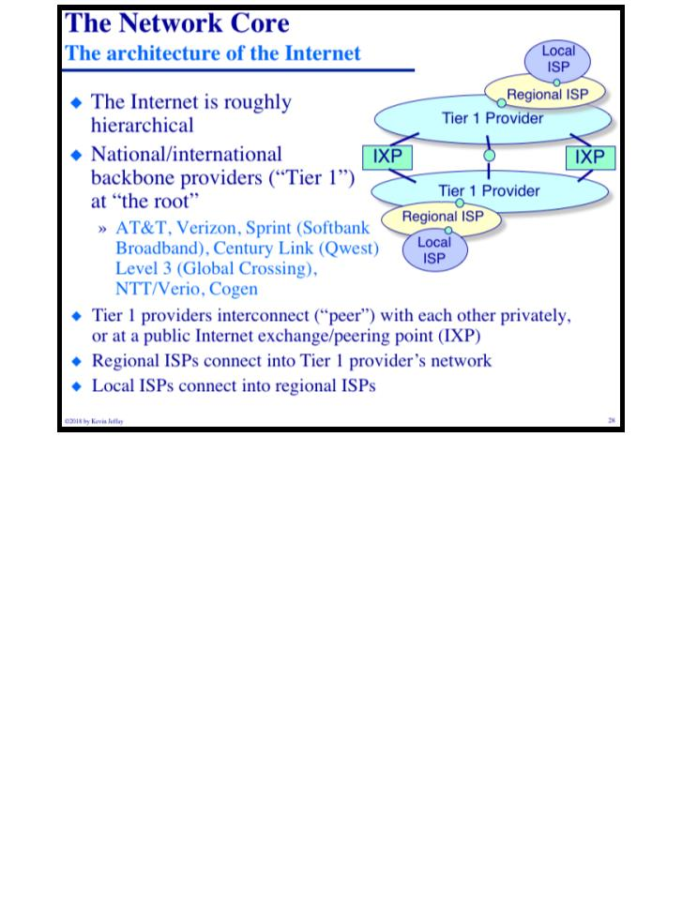
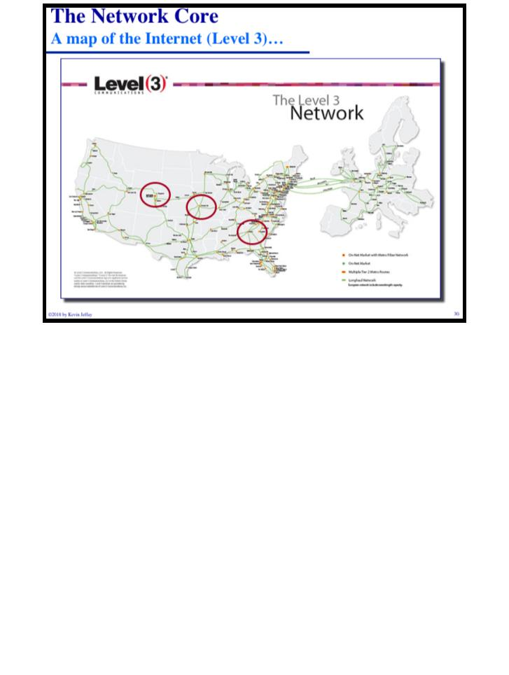
COMP 431
Lecture 1, WhirlwindIntro
August 27, 2018
COMP 431
© 2018 by Kevin Jeffay
Lecture 1, WhirlwindIntro
August 27, 2018
© 2018 by Kevin Jeffay
Page 28
Page 30
Notes:
NC State, Duke, and Chapel Hill are all connected by a regional ISP called MCMC. Tier 1 is something like Sprint and Verizon. IXP is somewhere where you plug your router into your competitors in a giant room so the internet is shared.

Slide 13
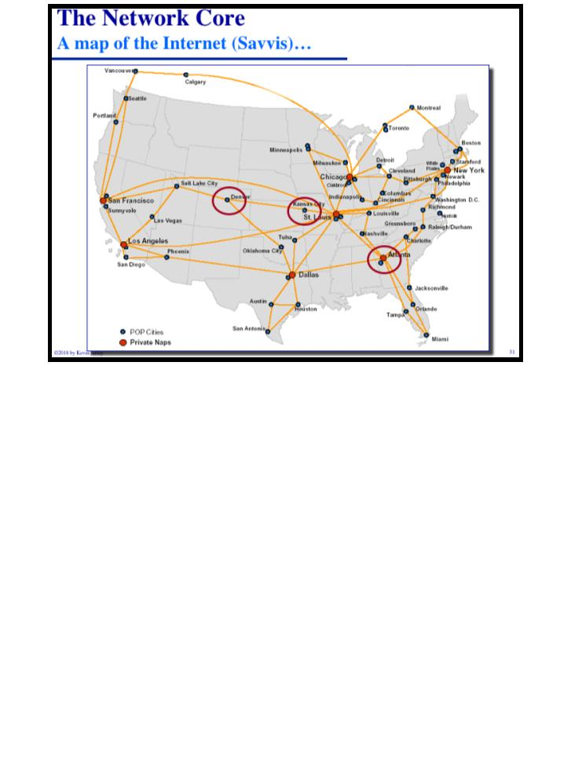
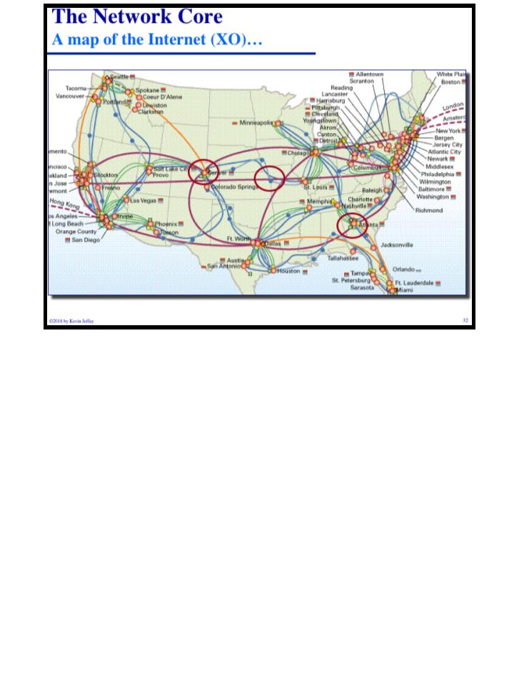
COMP 431
Lecture 1, WhirlwindIntro
August 27, 2018
COMP 431
© 2018 by Kevin Jeffay
Lecture 1, WhirlwindIntro
August 27, 2018
© 2018 by Kevin Jeffay
Page 31
Page 32

Slide 14
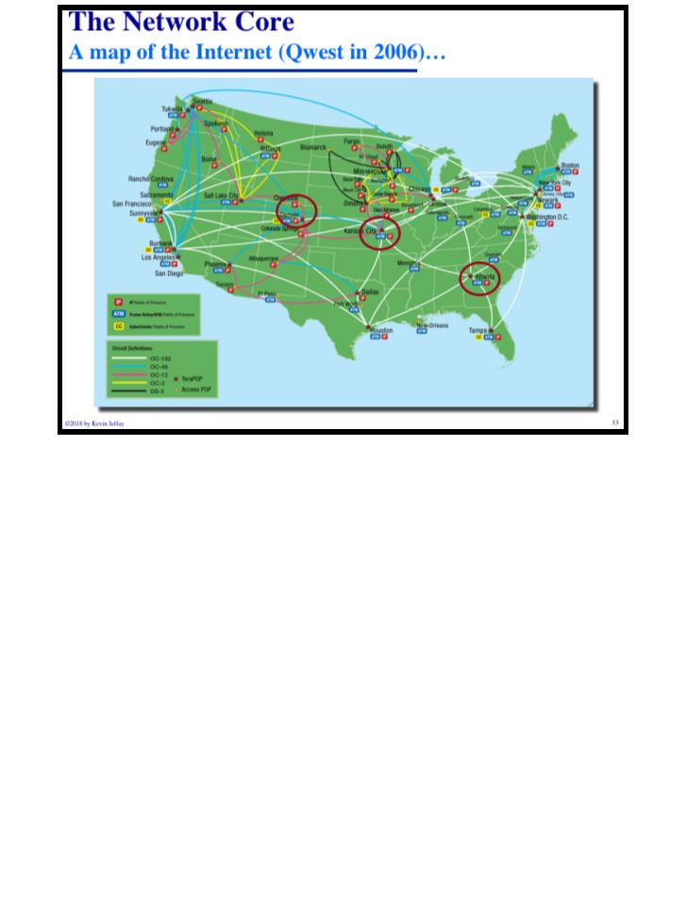
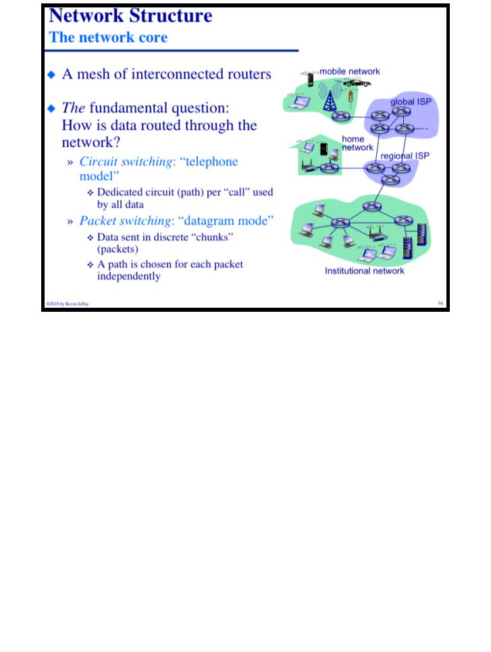
COMP 431
Lecture 1, WhirlwindIntro
August 27, 2018
COMP 431
© 2018 by Kevin Jeffay
Lecture 1, WhirlwindIntro
August 27, 2018
© 2018 by Kevin Jeffay
Page 33
Page 34
Notes:
Circuit switching: set up a path between a sender and a receiver where all of the data will go.
Packet switching: A path is chosen for each independent packet. A huge innolvation of the internet because it costs less and uses length better.

Slide 15
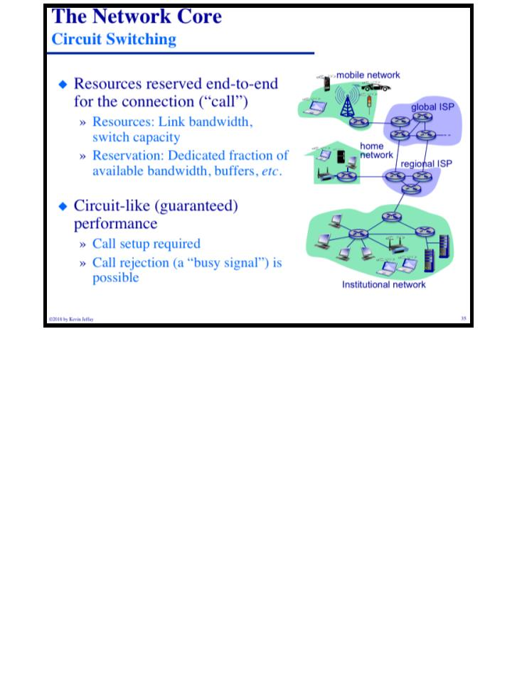
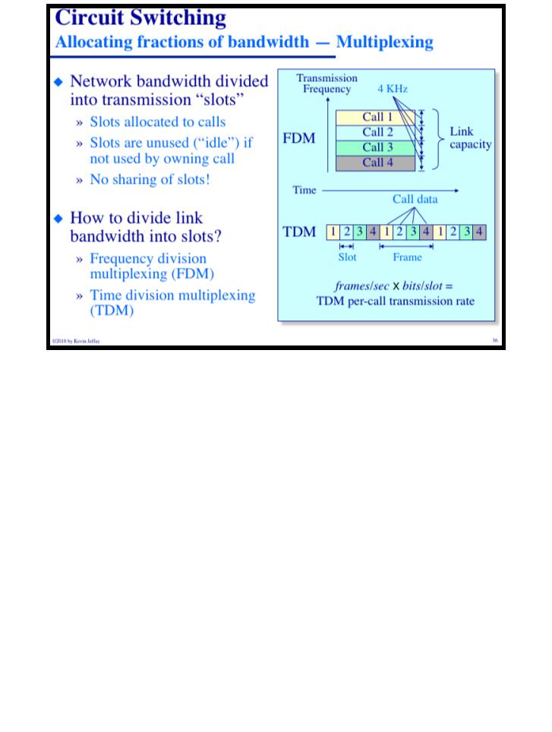
COMP 431
Lecture 1, WhirlwindIntro
August 27, 2018
COMP 431
© 2018 by Kevin Jeffay
Lecture 1, WhirlwindIntro
August 27, 2018
© 2018 by Kevin Jeffay
Page 35
Page 36
Notes:
Circuit Switching: you reserve the space and the protocol runs before you transfer any data. Could be rejected where there isn’t enough path.
Divide the network into slots, and then allot the slots to calls. FDM is multiple calls at the same time. TDM is that the calls all transfer some data periodically precisely after each other. In the example above, each slot is 125 microseconds, so even the computer can’t tell it’s not immediate.

Slide 16
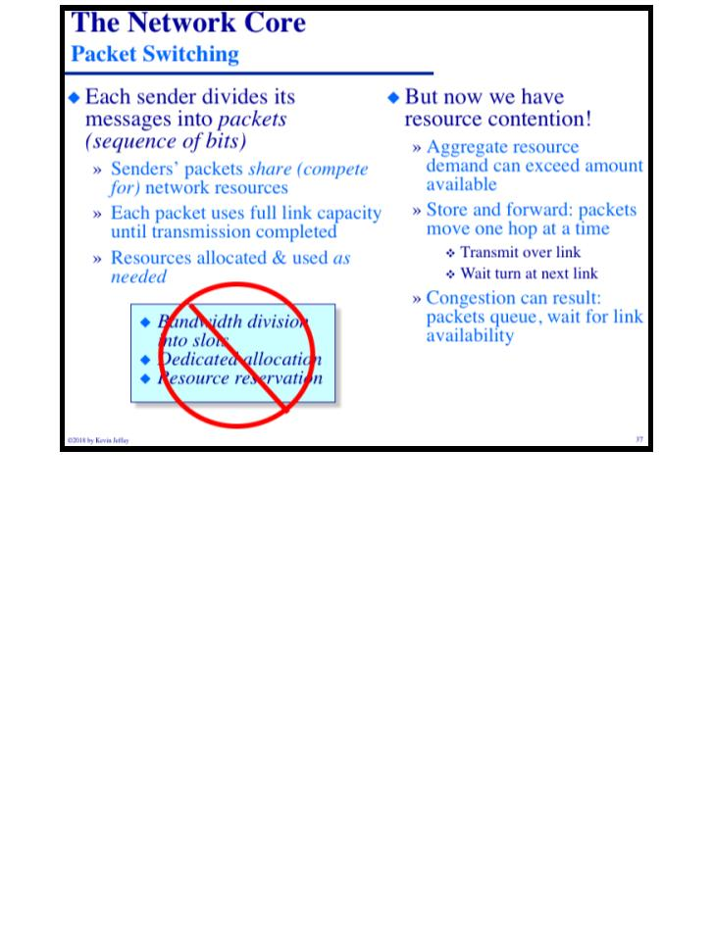
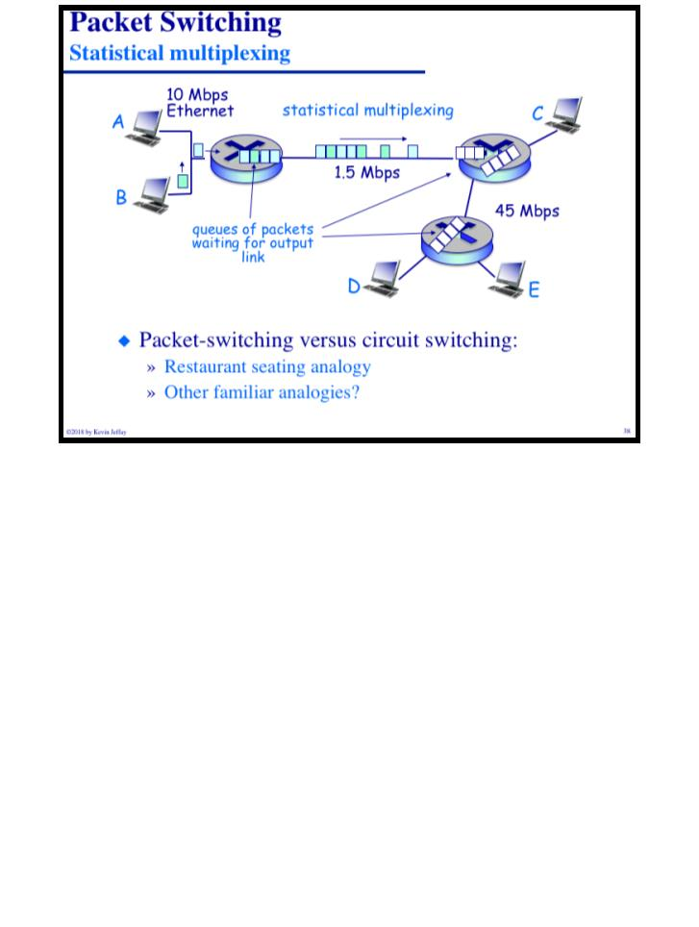
COMP 431
Lecture 1, WhirlwindIntro
August 27, 2018
COMP 431
© 2018 by Kevin Jeffay
Lecture 1, WhirlwindIntro
August 27, 2018
© 2018 by Kevin Jeffay
Page 37
Page 38
Notes:
Packet switching just starts chucking data forwards. Because you can have too many packets going through, there’s a process called store and forward.
Store and forward: receive entirely, then forward correctly. This means these devices need memory in order to store their buffer.

Slide 17
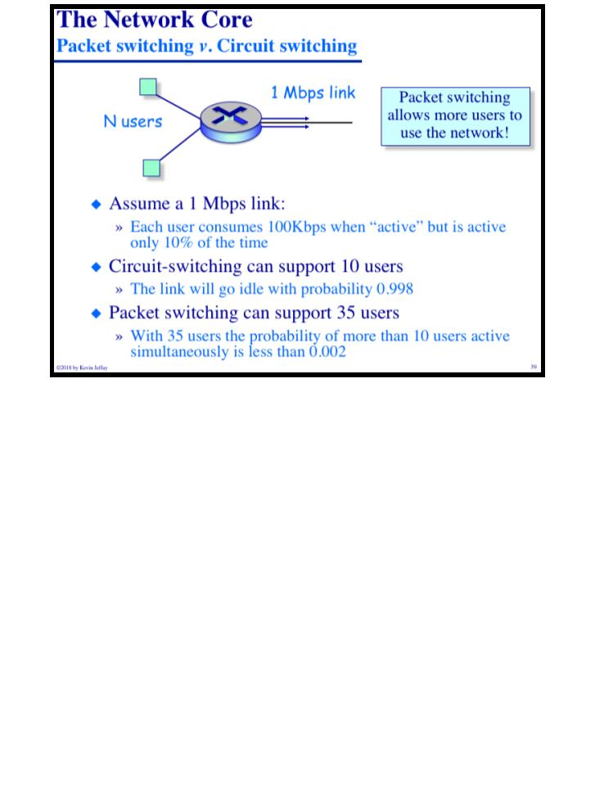
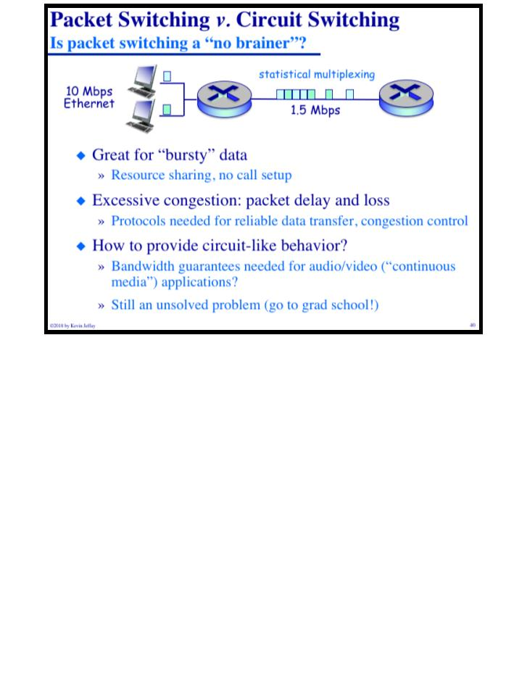
COMP 431
Lecture 1, WhirlwindIntro
August 27, 2018
COMP 431
© 2018 by Kevin Jeffay
Lecture 1, WhirlwindIntro
August 27, 2018
© 2018 by Kevin Jeffay
Page 39
Page 40
Notes:
Circuitry model was great for telefony because you’re constatntly talking. Packet switching makes sense because your computer does nothing for a while and then transmits a bunch. TCP is for when you have enough connection that you have to drop people using packet switching.

Slide 18
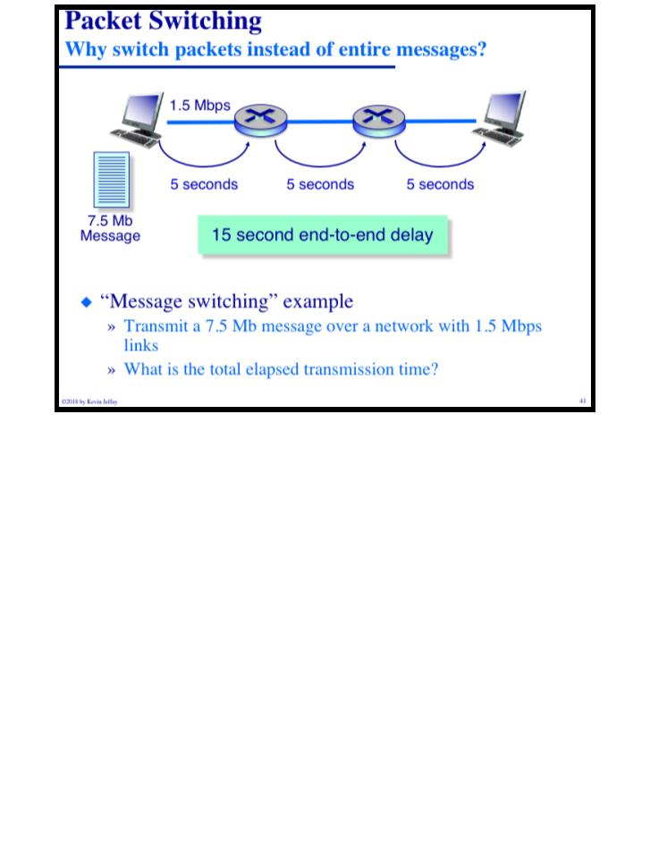
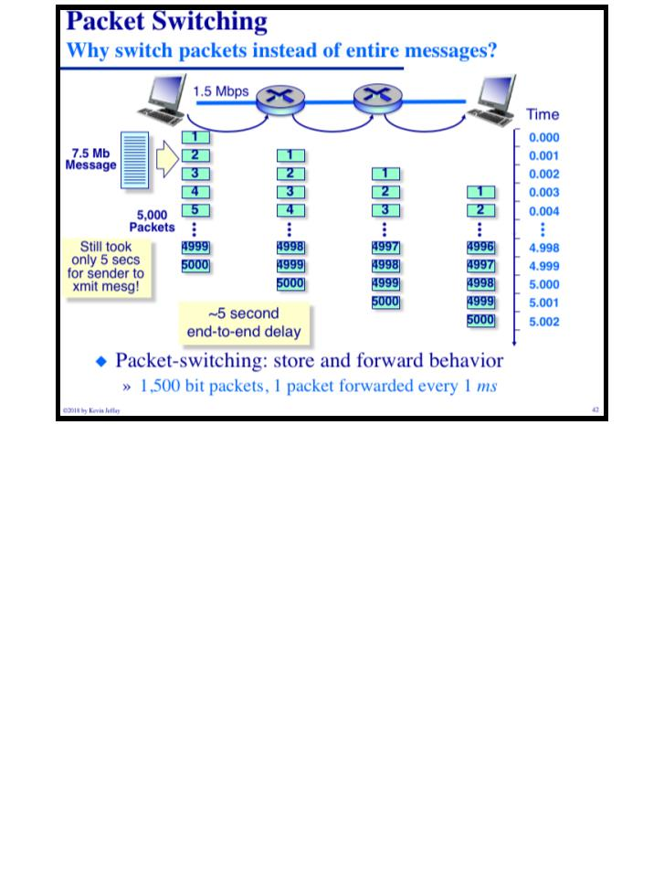
COMP 431
Lecture 1, WhirlwindIntro
August 27, 2018
COMP 431
© 2018 by Kevin Jeffay
Lecture 1, WhirlwindIntro
August 27, 2018
© 2018 by Kevin Jeffay
Page 41
Page 42
Notes:
Total elapsed transmission time is 15 seconds in the first example, which is packet switching with 1 package.
Total elapsed time in the second example is a teeny bit over 5 seconds, which is packet switching with 5k packages because the packages themselves are complete, meaning you don’t have to wait for the full file storage to forward the packages.
These are ’fluid networks’ because there’s no delay time between storing and forwarding.

Slide 19
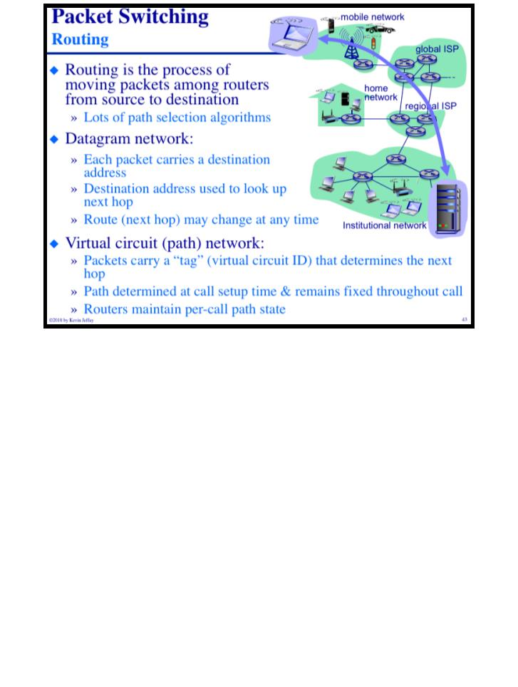
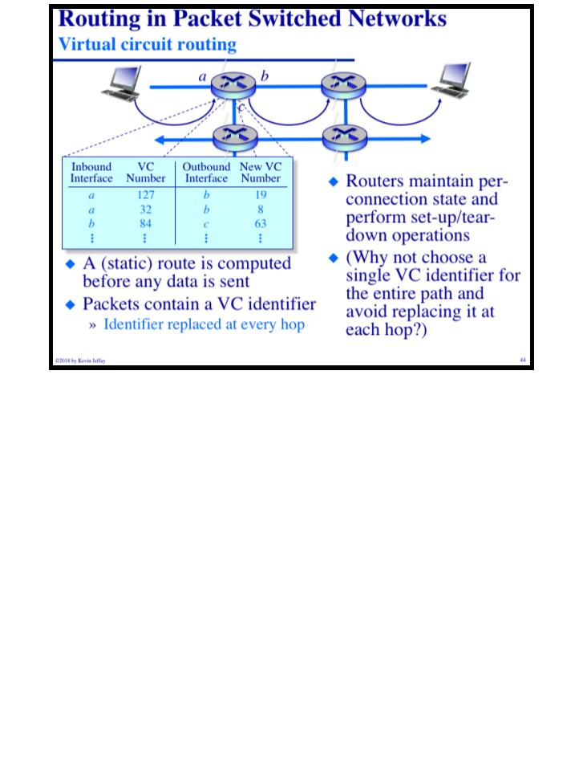
COMP 431
Lecture 1, WhirlwindIntro
August 27, 2018
COMP 431
© 2018 by Kevin Jeffay
Lecture 1, WhirlwindIntro
August 27, 2018
© 2018 by Kevin Jeffay
Page 43
Page 44
Notes:
Datagram Networks have a destination address, and that address determines the next hop (which is just a word in networking for the next router). These nodes have lookup tables that determine what the next hop should be.
VCPN: Packets have a tag that have a path that was determined ahead of time (just like circuit routing). The routers have to know something about every call in the entire network.

Slide 20
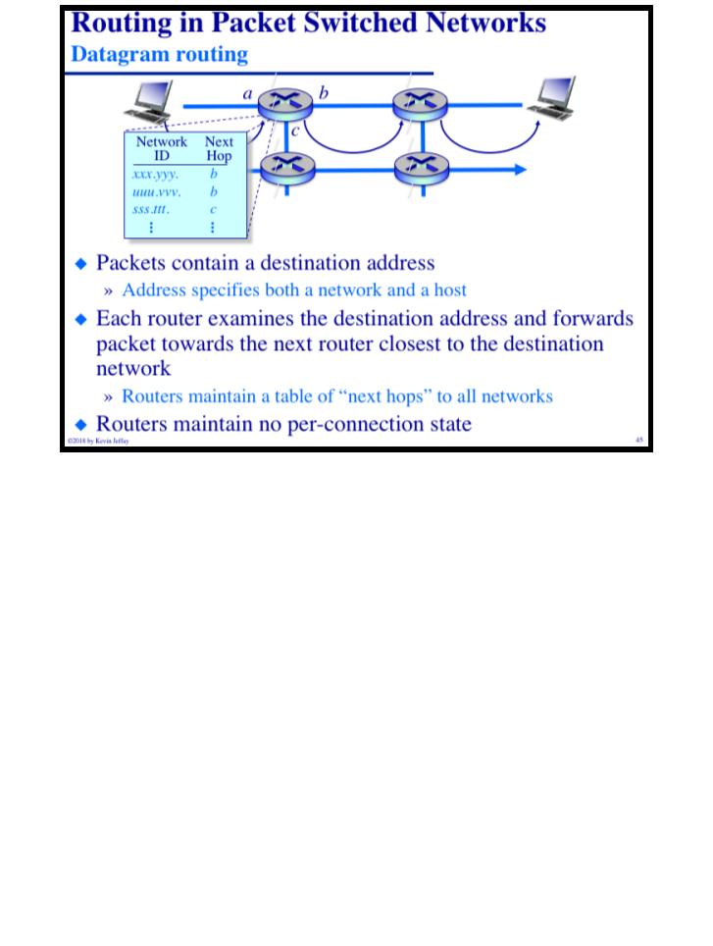
COMP 431
Lecture 1, WhirlwindIntro
August 27, 2018
© 2018 by Kevin Jeffay
Page 45

